Slide 1

UNIVERSITY REVIEWS
CAPSTONE PROJECT 1
MENTOR: HA THI NHU HANG

Slide 2
MEMBERS OF THE TEAM
01.
02.
03.
04.
NGUYEN VAN MINH TOI
NGUYEN HUU THIEN
HUYNH THI QUY THUONG
HO XUAN SANG

Slide 3
CONTENTS
OVERVIEW
WORK PROGRESS
DEMO

Slide 4
INTRODUCTION
OVERVIEW
University Reviews is a website that provides useful information about universities in Vietnam to help students make the right decisions when choosing schools and majors.

Slide 5
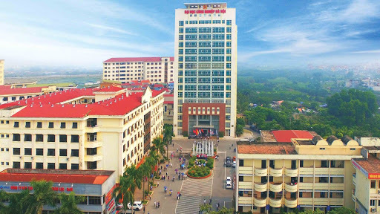
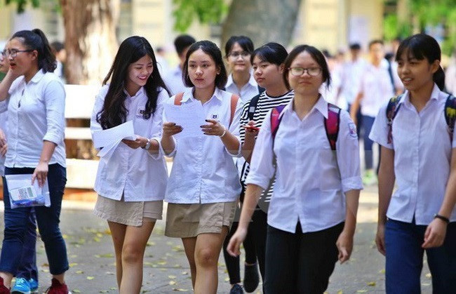
Lots of universities
Large number of students
WHY?

Slide 6
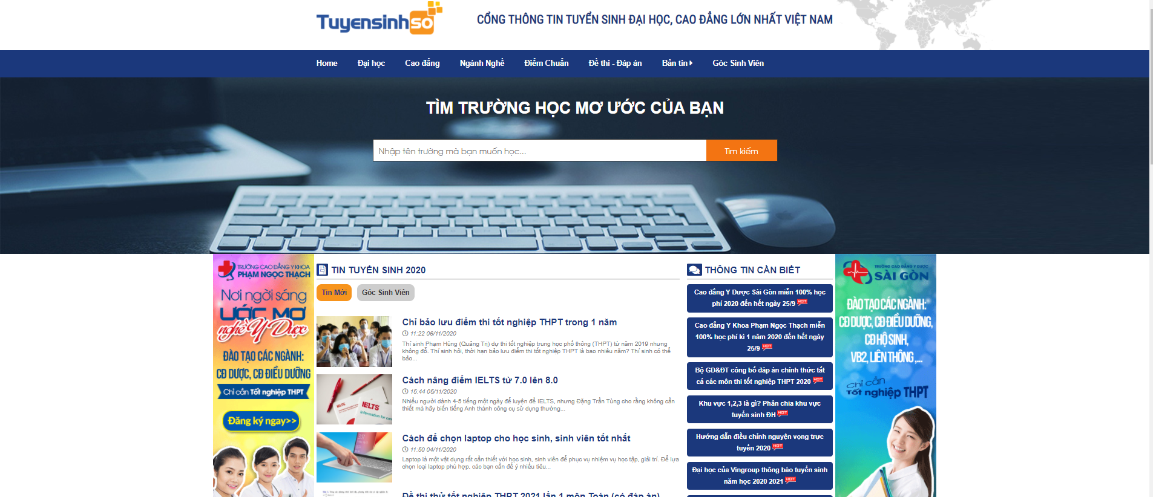
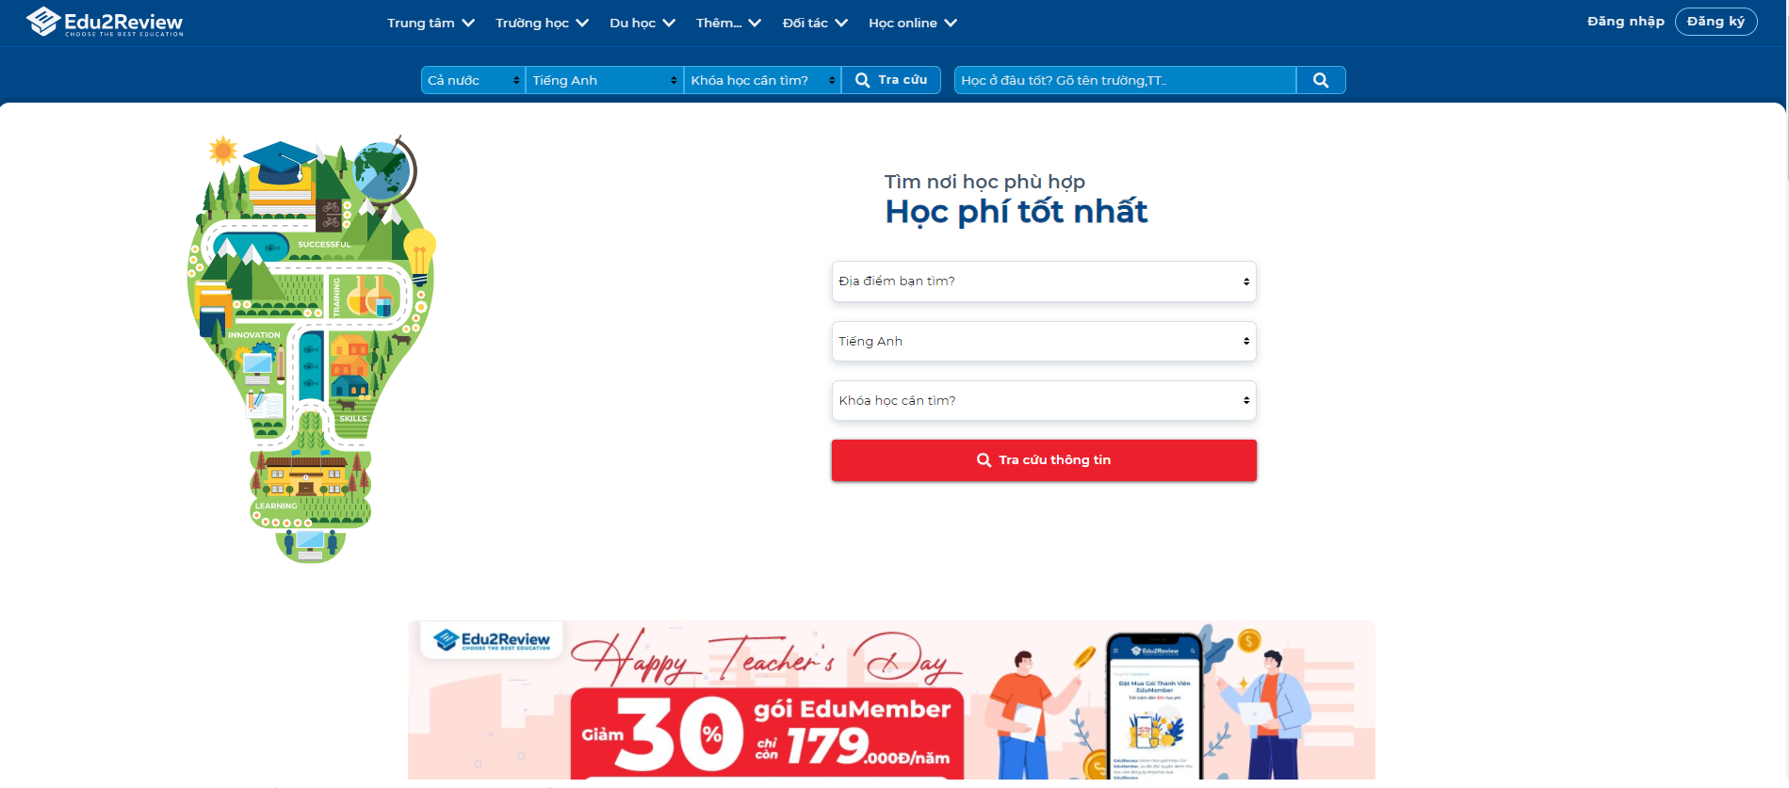
tuyensinhso
edu2review

Slide 7
Who?
admin
university
user
Managing general information of all users, updating accounts.
Search majors, universities, and learn about graduate programs, doctoral degrees, masters... Also, learn about jobs related to the profession you are studying after graduation.
Provides admission information about the school, an overview of the school, and provides information about the school's programs and career information.

Slide 8
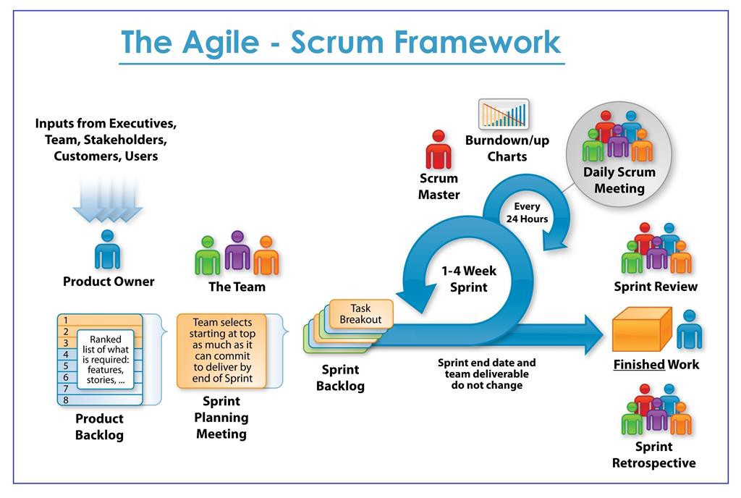
The scrum process
WORK PROGRESS

Slide 9




Process
Sprint 1
Sprint 2
Sprint 3
Sprint 4
Finished
Finished
Processing
Unfinished

Slide 10
DOCUMENTS
PROPOSAL
SPRINT BACKLOG
PROJECT PLAN
USER INTERFACE DESIGN
USER STORY
DATABASE DESIGN

Slide 11
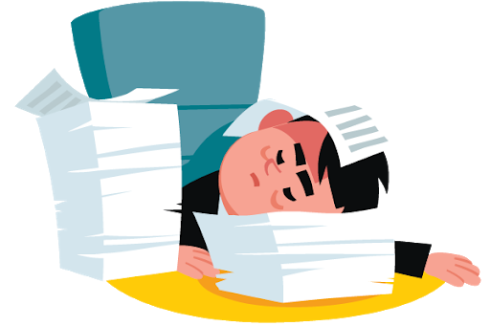
Problems encountered
Unfinished achitecture documentation
Have not written test documents

Slide 12

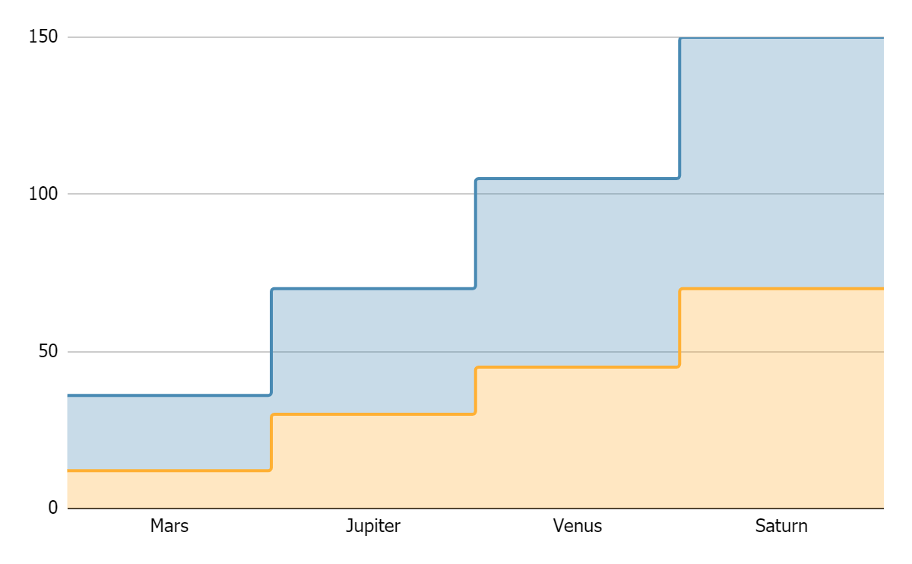
TOPIC DATA
Mercury
Pluto
If you want to modify this graph, click on it, follow the link, change the data and replace it

Slide 13




RECOMMENDATIONS
MARS
VENUS
JUPITER
SATURN
Despite being red, Mars is actually a cold place
Venus has a beautiful
name, but it’s hot
It’s the biggest planet in our Solar System
Saturn is the ringed one
and a gas giant

Slide 14




PRACTICAL EXERCISE
Mercury is the closest planet to the Sun and the smallest one in the Solar System—it’s only a bit larger than our Moon. The planet’s name has nothing to do with the liquid metal, since it was named after the Roman messenger god, Mercury

Slide 15
THANKS!
Does anyone have any questions?
youremail@freepik.com
+91 620 421 838
yourcompany.com

Slide 16
ALTERNATIVE RESOURCES

Slide 17
RESOURCES
Did you like the resources on this template? Get them for free at our other websites.
VECTORS
People working at the office flat design
Collection of young men and women reading
Set of young men and women reading
Flat business landing page template
People at the office
People at the office
Flat world book day banners
Office workers sitting at desks
PHOTOS
Close-up of woman doing her work
If you want to apply the same filter as the picture included in the template, follow these instructions:
IN GOOGLE SLIDES:
Insert the picture in the slide.
Go to Format options and recolor the picture by applying a black & white filter.
Create a shape with the same size as the picture and fill it with the #ffad802f color.
Place the shape on top of the picture. You can adjust the transparency as you see fit.

